Slide 1
Software Testing
Test Automation* (Part 2)
Presented By
Ning Chen, Ph.D.
Professor
Department of Computer
Science
California State University,
Fullerton
© Ning Chen, 2017
*
*Based on Advanced_syllabus of ISTQB

Slide 2
Module Objectives
This module focuses on understanding test automation

Slide 3
Road Map
Objectives for Test Automation
Test Automation Preparation
Test Automation Architecture
Test Automation Risks
Test Automation Reporting and Metrics
Continuous Improvement (CI)
People Skills

Slide 4
The Generic Test Automation Architecture
The gTAA presents the layers, components, and interfaces of a gTAA, which are then further redefined into the concrete TAA for a particular TAS. It allows for a structured and modular approach to building a test automation solution by:
  Defining the concept space, layers, services, and interfaces of a TAS to enable the realization of
  TASs by in-house as well as by externally developed components
  • Supporting simplified components for the effective and efficient development of test automation
  • Re-using test automation components for different or evolving TASs for software product lines and
  families and across software technologies and tools
  • Easing the maintenance and evolution of TASs
  • Defining the essential features for a user of a TAS

Slide 5
Overview of the gTAA
The gTAA is structured into horizontal layers for the following:
  Test generation
  Test definition
  Test execution
  Test adaptation

Slide 6
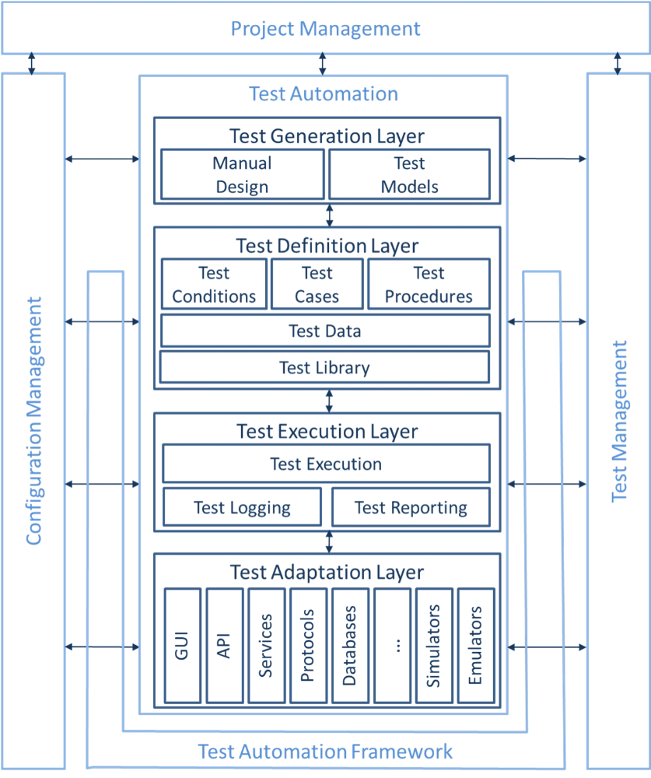
Overview of the gTAA

Slide 7
TAA Design
There are a number of principal activities required to design a TAA, which can be ordered according to the needs of the test automation project or organization.

Slide 8
TAA Design Activities
Capture requirements needed to define an appropriate TAA
Compare and contrast different design/architecture approaches
Identify areas where abstraction can deliver benefits
Understand SUT technologies and how these interconnect with the TAS
Understand the SUT environment
Time and complexity for a given testware architecture implementation
Ease of use for a given testware architecture implementation

Slide 9
Approaches for Automating Test Cases
Well-established approaches for automating test cases include:
  Capture/playback approach
  Structured scripting approach, data-driven approach, and keyword-driven (action-word-driven) approach
  Model-based testing (including the process-driven approach)

Slide 10
TAS* Development
Development of a TAS is comparable to other software development projects. It can follow the same procedures and processes including peer reviews by developers and testers. Specific to a TAS are its compatibility and synchronization with the SUT.
*TAS – Test Automation Solution can be viewed as an implementation of TAS – Test
Automation Architecture.

Slide 11
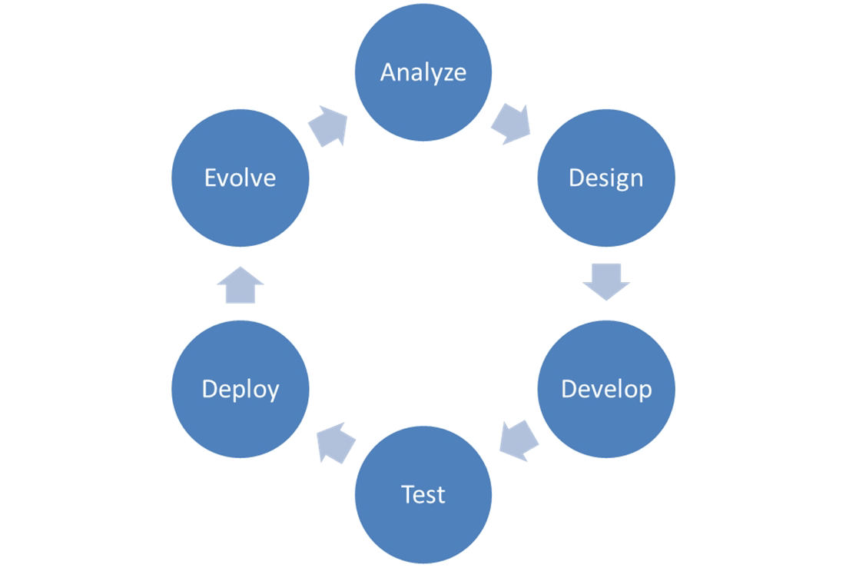
TAS* Development
The basic SDLC for TAS is:

Slide 12
Synchronization of SUT and TAS evolution
Both the SUT and the TAS can evolve to accommodate new features or disable features, to correct defects, or to address changes in their environment.

Slide 13
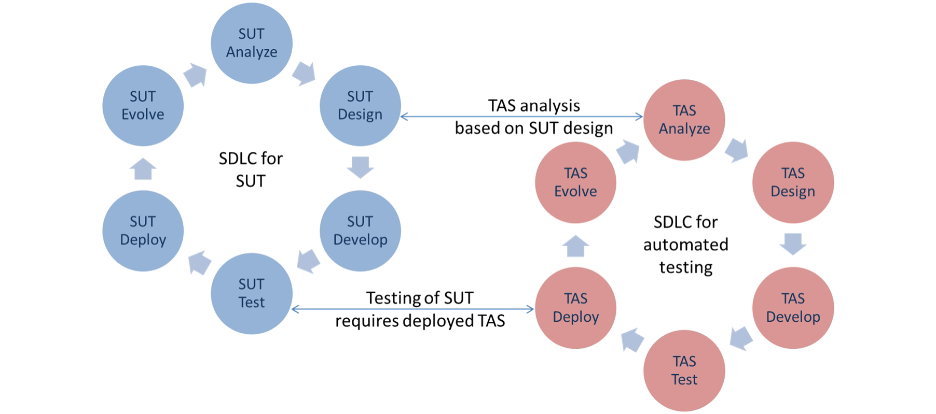
Synchronization of SUT and TAS evolution

